Slide 1
RAPTOR Progress
Sam Kelly
Jeff Byers

Slide 2
Variance
A statistical measure of how far a set of numbers is spread out
A variance of zero indicates that all the values are identical
Always non-negative
A small variance indicates that the data tend to be very close to the mean (expected value)
A high variance indicates that the data are very spread out around the mean and from each other

Slide 3
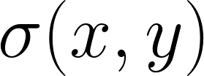
Covariance
A statistical measure of the degree to which two random variables change together
If x is large when y is large, and x is small when y is small, then the covariance is positive
If x is large when y is small, and x is small when y is large, then the covariance is negative
The sign of covariance thus illustrates the linear relationship between two random variables
Covariance of x, y denoted

Slide 4

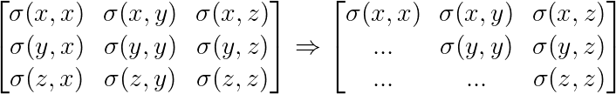
Covariance Matrix
Element at i, j is the covariance between the i^{th} and j^{th} elements of a random vector (that is, of a vector of random variables)
Generalizes variance to multiple dimensions
e.g. a collection of points in 2D or 3D space

Slide 5
Covariance Matrix
Can be calculated very quickly for a 2D or 3D point cloud using basic linear algebra operations
Variation between xx, yy, zz, xy, xz, yz implicitly encodes pose information of a collection of 3D points
Formally, the eigenvalues of an n-dimensional covariance matrix define an n-ellipse capturing the size, shape, and orientation of the original data
Sometimes used as a feature vector for classification and pose estimation of 2D (image) and 3D (i.e. LIDAR) data
Connected with the idea of “image moments”

Slide 6
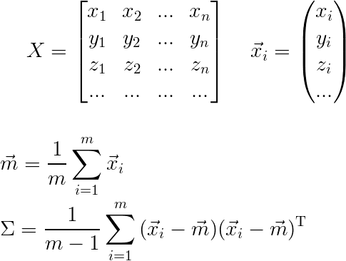
Covariance Matrix
The following will produce the d x d covariance matrix for a d-dimensional point cloud:

Slide 7
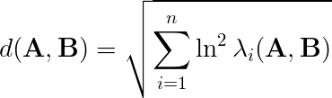
Covariance Matrix Distance Metric
“A Metric for Covariance Matrices” (Förstner, 1999). This metric is “...invariant under affine transformations and inversion”
Commonly used today for 3D pose estimation and 3D reconstruction
Typically used only in situations where LIDAR or depth-based data is available, but is applicable to 2D data as well
For our purposes, measures the “distance” in n-dimensional pose space between two n-dimensional point clouds
This is really the length of the geodesic between matrix A and matrix B along the manifold of all possible d x d covariance matrices
Covariance matrices for two 3D point clouds representing the same 3D model with a slight difference in scale, rotation, or translation would yield a small distance
Covariance matrices for two point clouds representing the same 3D model with a dramatic difference in scale, rotation, or translation would yield a large distance

Slide 8
RAPTOR: Plan A
Try to learn (via ANNs) 3D distance and orientation (pose) directly
  Will use 2 x 2 covariance matrix for thresholded version of the input image as an input feature vector
  Will possibly augment this with a scaled-down version of the input pixel grid
  Could try to learn to output 3 x 3 covariance matrix rather than pose parameters
  Might use stereo vision based on two sequential input frames rather than one to yield a richer 3 x 3 covariance matrix feature vector (though this might be dangerously similar to existing techniques)
  We expect that (at least without stereo vision) Plan A will be too difficult for shallow ANNs to learn, but it is very easy to test so we will try it anyway

Slide 9
RAPTOR: Plan B
Calculate the distances between the input pose and several reference poses and use this information as a feature vector or search heuristic
  Reference poses are chosen so that each degree of freedom (rotx, roty, rotz, dist) has a unique pose corresponding with its minimum and maximum value
  e.g. if rotation parameters vary from 0 to 2pi , and distance can vary from 0 to 100, then the min and max x rotation poses would be (0, pi, pi, 50) and (2pi, pi, pi, 50)
  The average of these distances should be an admissible heuristic for searching within this space so long as the 3D model is sufficiently complex (will prove this)
  Could use this information as a feature vector for an ANN
  The training data forms a 4-dimensional space where each point represents a 3D pose (orientation and distance from camera)
  Might use this heuristic with data clustering, locality-sensitive hashing, or space-partitioning data structures instead of an ANN if this proves feasible
  Would be extremely fast since covariance matrices for reference poses could be precomputed
  Might combine one of these techniques with stereo vision so we are working with 3 x 3 covariance matrices

Slide 10
RAPTOR: Plan C
Leverage RAPTOR's ability to produce on-the-fly renderings of arbitrary poses (and the corresponding 2D and 3D covariance matrices) to zero in on the correct 3D pose through an iterative guess-and-check procedure
Basic process would be as follows:
  1. generate guess 3D pose
  2. render pose and calculate 2 x 2 (2D) covariance matrix for that pose
  3. measure distance between guess 2 x 2 covariance matrix and input image 2 x 2 covariance matrix
  4. Come up with better guess, and repeat until correct pose is found
Would probably use something similar to nearest neighbor search

